Slide 1
IBM Watson
THEME
SCENARIO
Demonetization
Team :
Spartan777 Lead : Vinit Ganorkar

Slide 2
CONTENTS
Team Members
Theme Introduction
Scenario
Solution Architecture
Benefits Of Using a Bot
Features
Technology Stack
Integration with Application
Security
Wow Factor
Future Scope
Conclusion

Slide 3
Team Members
Vinit Ganorkar
Programmer Analyst at Cognizant
Suresh Penta
Senior System Engineer
Nikita Banthiya
Software Developer

Slide 4
Theme introduction
Theme is about the Demonstration of a power of digital and cognitive technology where a quick deployment of a mass personalized rollout needs to be carried out.
We can consider any private or government institution which needs to rollout a new capability for its constituents.
The key is that the scenario required "personalization at scale“.

Slide 5
Scenario
Our Scenario is similar to demonetization where government decides to ban 500 and 1000 Rupees notes overnight which created lot of chaos in people.
People were flooded with lot of questions in their head like why? When? Where? how to? what next?
ATM’s were cashless banks had long long queues and many people were unaware about the changing policies.
We feel this is the best scenario to implement a cognitive bot and showcase it’s power of allowing personalization at scale.

Slide 6



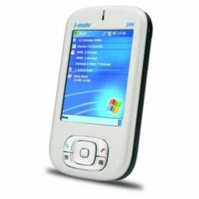

Solution Architecture
Users
Interface
Watson Conversation Service
Telegram
Node RED
BlueDisc Bot Application
Messenger
Text SMS

Slide 7
Benefits of using a bot
We can save on human capital required to maintain and establish such mass rollouts.
We can also avoid risks around process compliance and training and in human validation too.
Tracking the success of the program after rollout can be done easily by doing data analysis on the bot conversations with human.
Cognitive service provides the required levels of human engagement, expertise, personalization and continuous, data-driven improvement.

Slide 8
Features
Our Bot named BlueDisc can answer many generalized and common queries people have regarding sudden announcement of demonetization.
Time to time Policy updates can be given to audience.
Individual citizen can get the facts delivered on his smartphone through a Bot.

Slide 9
Technology Stack
IBM Watson API’s.
IBM Bluemix Conversational service.
Jason for creating flow in Node-RED.
Telegram App API

Slide 10
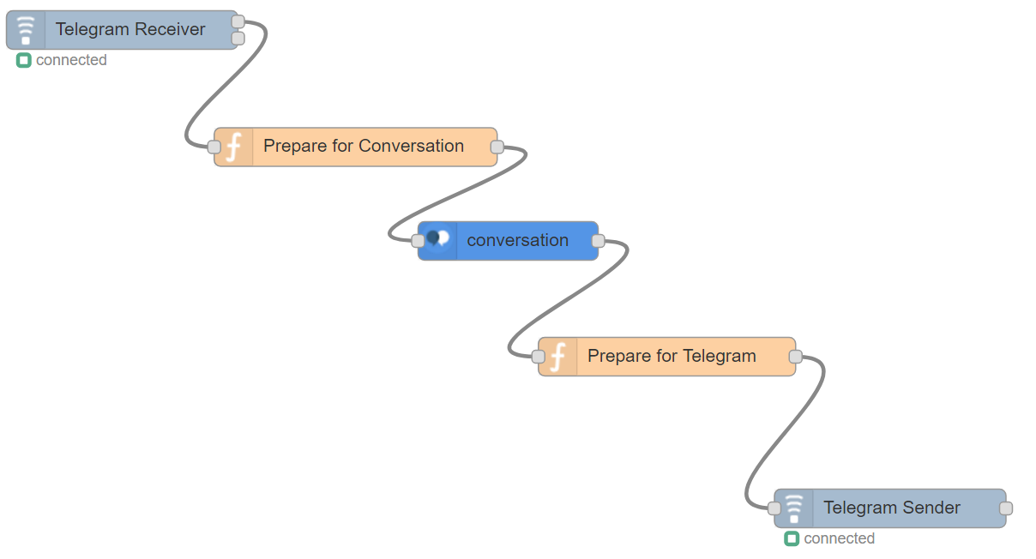
Integration with Application
We are integrating our BlueDisc Bot to Telegram using node red flow diagram shown below :

Slide 11
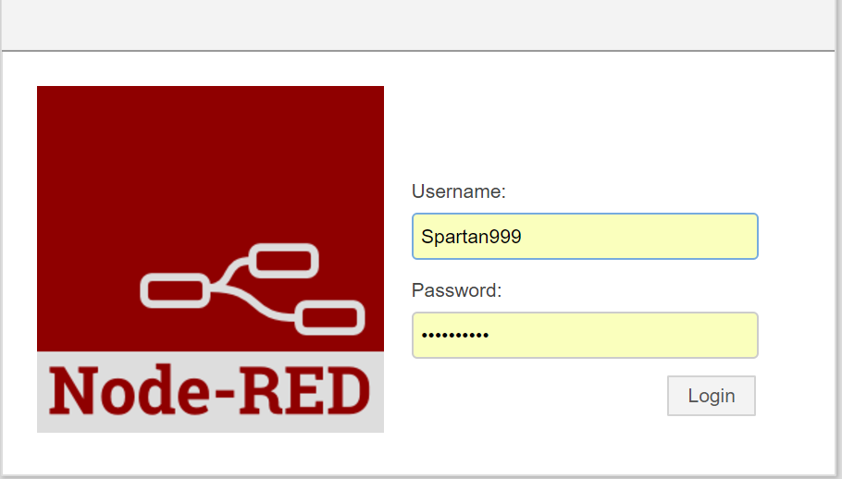
security
All the details are well protected by workspace ID and other credentials
Access to Node-RED can damage the application flow and so it’s well protected using node-RED security:

Slide 12
Wow Factor
Bot can get a bank token for you to deposit money in Bank so that no one has to stand in the long queues.
Our Bot can answer many queries like :
What is the cash withdrawal limit ?
What is the cash deposit limit ?
When can I expect a cash been deposited to my nearest ATM ?
Any new policy updates ?

Slide 13
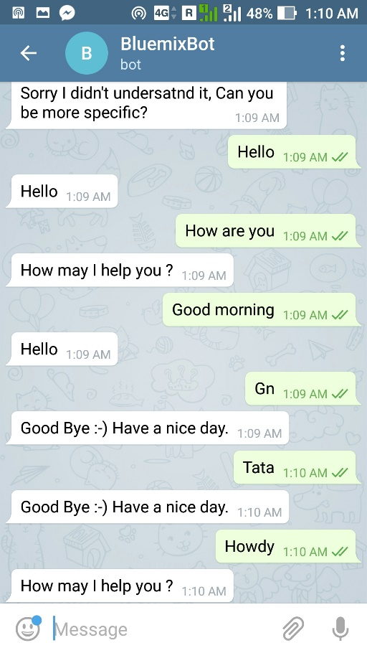
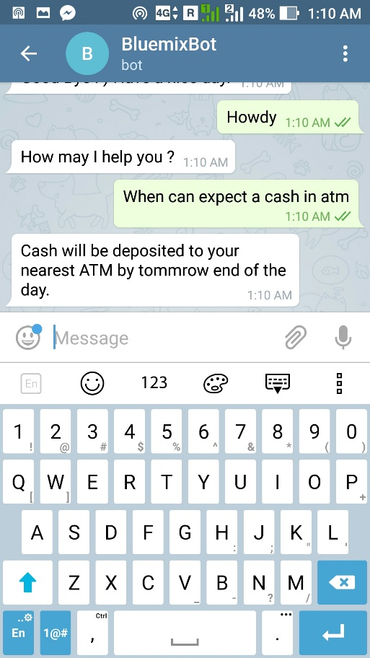
Wow Factor

Slide 14
Future Scope
We can provide Bot integration to more platforms such as Facebook messenger and SMS to reach out to larger audiences.
We can you other Watson services such as speech to text and test to speech.
We can integrate google map service to find nearby ATM cash availability status by automatically detecting users location.
We can use Watson’s language translator services to make bot communicate in native languages.

Slide 15
?

Slide 16
THANK YOU!!!

